Slide 1
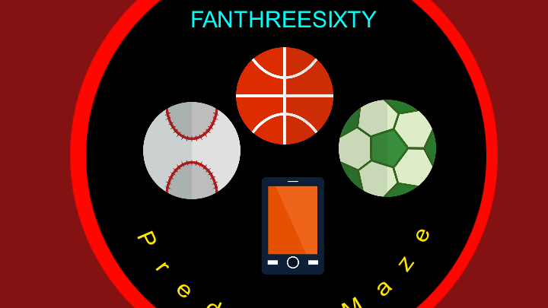
PREDICT MAZE
(Requires BRAINS AND LUCK)
Developed by -
MIHIR PITALE & ABHISHEK HALDER

Slide 2
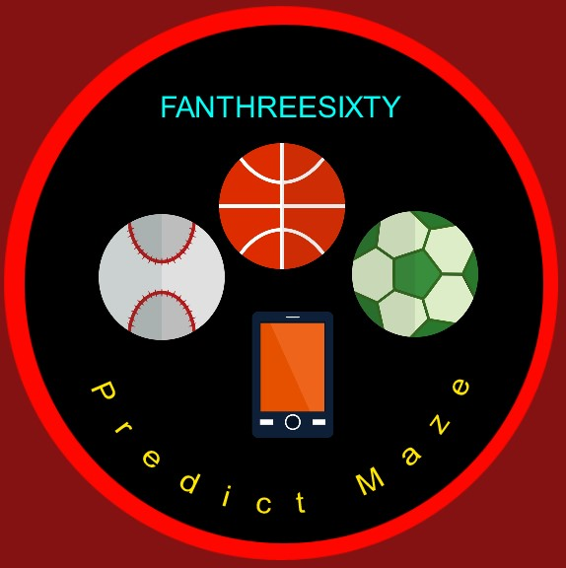
App logo

Slide 3
Contents
Introduction
Layouts Fragments
Firebase (Server)
Rankings
Prediction Mode
Trivia Quiz Mode
Server Messages and Doodle Pool
App benefits to user
Future scope

Slide 4
INTRODUCTION
PREDICT MAZE is developed on android platform (Nougat).
Showcases various options and ways to connect with fans
Competes with them via predictions and awarding them with hampers.
Makes fans more involved in live match.
Uses Firebase as the database so that data is saved virtually and would never be lost
Connects fans from same club and brings them together forming a happening community via push notifications.

Slide 5
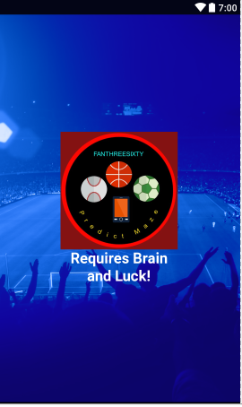
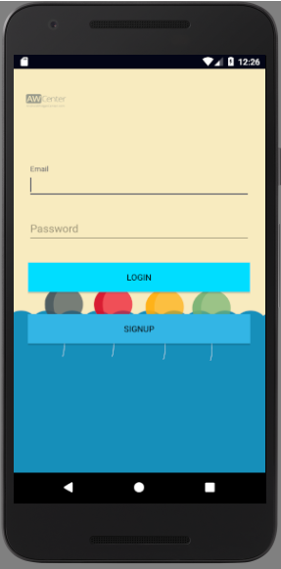
Predict Maze (Layouts)
1st Layout- A splash page appearing for 5 seconds
2nd Layout- Login Page
3rd Layout- User Registration Page
4th Layout- Home page with categories and rankings
5th layout- Start page for PLAY!
6th Layout- Questions and Answers page
7th Layout- Play again page
8th Layout- Rankings Page
9th Layout- Detailed score page
10th Page- menu page with add-ons like chat in future

Slide 6
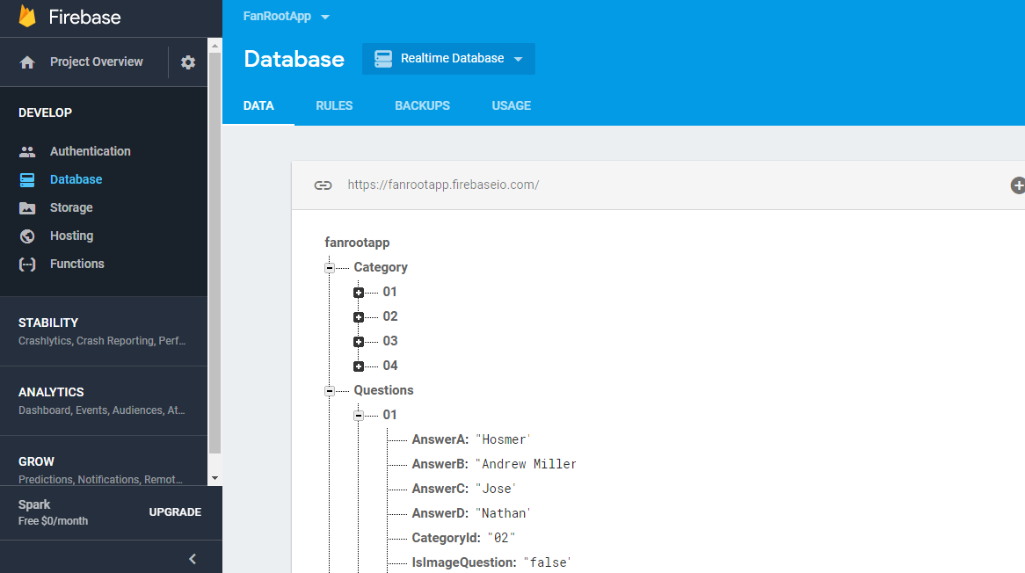
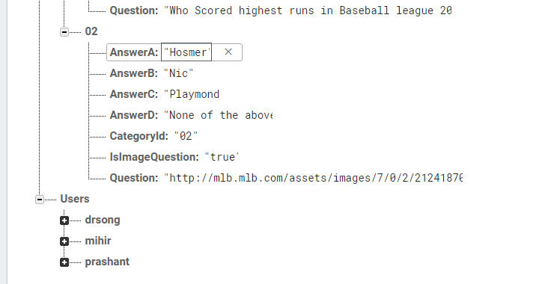
Firebase ( Server)
Firebase is the Server and database for this application
Fire base has data of fixed questions for trivia quiz which would be updated manually
It gives push notifications to every user about events by sending them doodle pool link to enrol in.

Slide 7
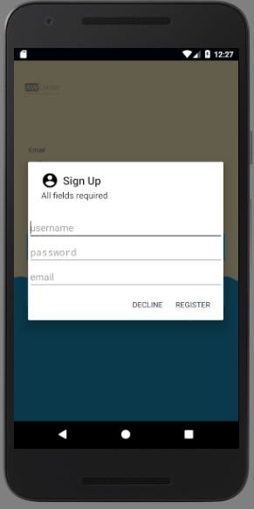
User Registration

Slide 8
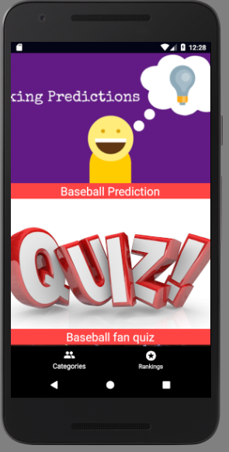
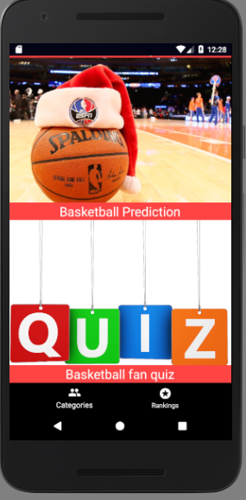
Layout(fragments)
After user is logged in, there are 2 main fragments and four modes
CATEGORIES-
Baseball prediction
Baseball quiz
Basketball prediction
Basketball Fan quiz

Slide 9
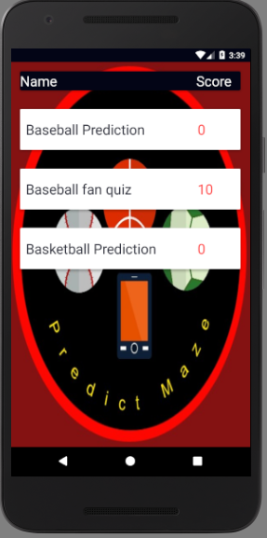
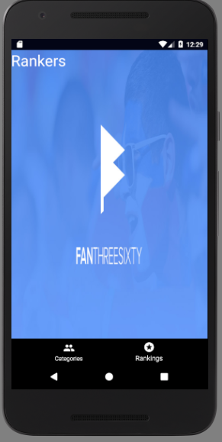
(Rankings)
shows scorecard of every user and keeps updated through top 5 scorers.
Gives detail score of each segments.

Slide 10
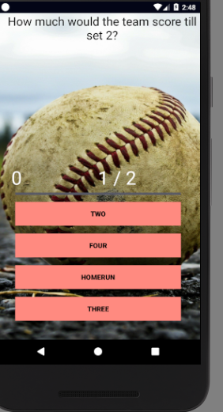
Prediction Mode
In this category, every user would be allotted 5 predictions as the live match begins
Each correct answer would give user 50 points
Each wrong answer would deduct 10 points from his scorecard.
Questions would be changed per day as required

Slide 11
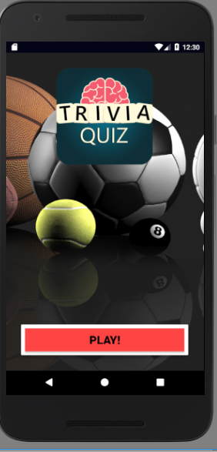
TRIVIA QUIZ MODE
Sets of questions about Kansas City teams would be updated every week
correct answer gives user 10 points wrong would deduct 10 points
Questions would be easier compared to prediction mode
There would be 5 sec for each question.

Slide 12
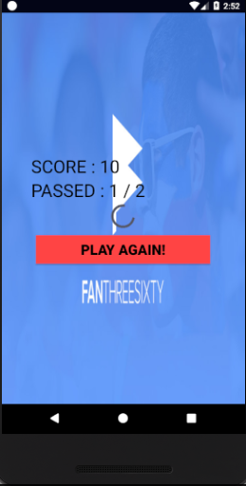
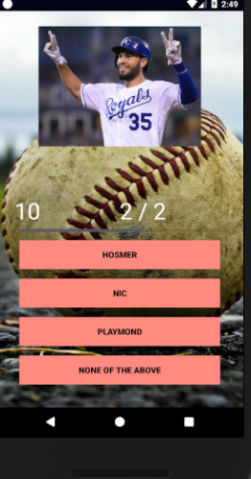
QUIZ (Continued)

Slide 13
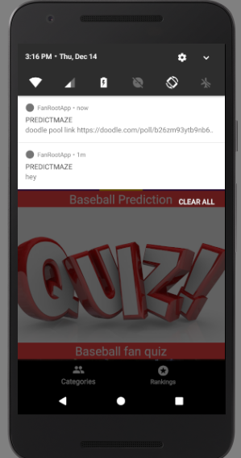
Server messages and doodle pool

Slide 14
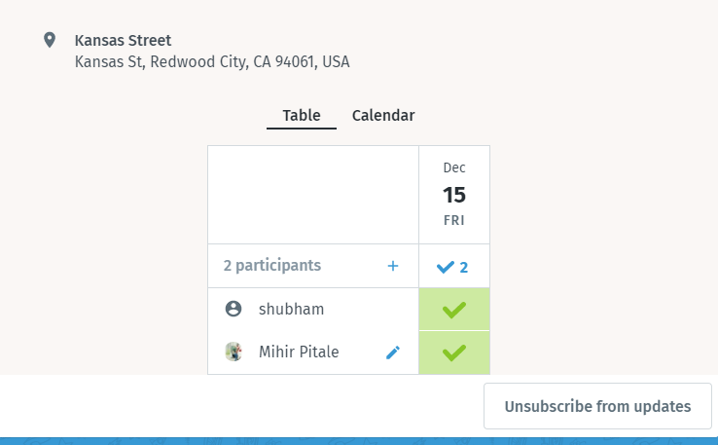
Doodle pool points
User would get offline points via attending and enrolling through doodle poll events

Slide 15
Why would user download this app?
For better knowledge about Kansas City teams and players playing matches
To engage more deeply in live match due to prediction mode
to participate in events held by app and meet new friends supporting same teams
To get a small bumper prize every month making it addictive to play daily!
To chat with other users
To know schedule of matches and events posted through doodle pool

Slide 16
FUTURE SCOPE
Advance booking of tickets via third party seller can be programmed
Developing and adding More features in send bird chat application
Selling online team merchandise through application advertisements
Linking app to the company’s website
Collecting database of how frequent is the user using application

Slide 17

THANK YOU

